Slide 1
Atomic Widgets
October 31, 2014
Notes:
Guidewire training materials contain Guidewire proprietary information that is subject to confidentiality and non-disclosure agreements. You agree to use the information in this manual solely for the purpose of training to implement Guidewire software solutions. You also agree not to disclose the information in this manual to third parties or copy this manual without prior written consent from Guidewire. Guidewire training may be given only by Guidewire employees or certified Guidewire partners under the appropriate agreement with Guidewire.
<number>

Slide 2
Create atomic widgets
Bind an atomic widget to the data model
Create and modify widget labels
Differentiate between static and dynamic widget properties
Notes:
<number>

Slide 3
Atomic widget fundamentals
Creating atomic widgets
Binding widgets to the data model
Widget labels and display keys
Widget properties
Deploy the PCF and display keys
Notes:
<number>

Slide 4
Atomic widgets
PCF Element
Widget
Location
Atomic Widget
An atomic widget is a graphical user interface element that is non-divisible
An atomic widget displays individual data values OR executes individual actions
Input and cell widgets bind data values
Data values often associated with root objects, query objects, or related objects
Input
Cell
Button
Notes:
A widget is a graphical user interface element responsible for interacting with the user. "Widget" is a Java specific, industry term. Widgets maintain and draw their state using some combination of graphical drawing operations. Using the mouse or the keyboard, the user can change the state of a widget. When a state change occurs, whether initiated by the user or the application code, widgets redraw to show the new state.
Both Widget and Location are conceptual representations in this diagram. There are no <Widget /> or <Location /> elements. Atomic Widget is also a conceptual representation. There is no <AtomicWidget /> element.
A location is a place to which you can navigate in the interface. Locations are used primarily to provide a hierarchical organization of the interface elements, and to assist with navigation. PCF elements that are consider locations include pages, wizards, worksheets, forwards, and location groups.
A widget is a PCF element that a Guidewire application renders into an HTML object. Buttons, menus, text boxes, and dropdown lists are all examples of PCF elements that are considered widgets. Some widgets that are not visually presented in the web browser, but are rendered as an HTML object, such as a hidden input.
<number>

Slide 5
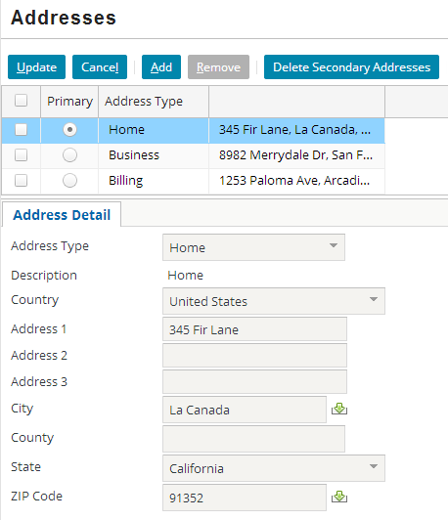
Atomic widgets: examples
Button
Use to execute actions, typically in toolbars
Cell
Use to display and edit data in list views
Input
Use to display and edit data in detail views
Layout (see notes)
Notes:
Layout widgets help organize the user interface to improve usability and legibility. Common layout widgets include the label widget and the input divider widget. For label widgets, you specify a value for the label property. For input divider widgets, there are no properties to specify.
<number>

Slide 6
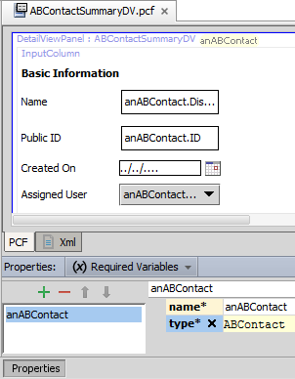
Input and cell widgets bind data
Input and cell atomic widgets often bind to data
From variable object(s) defined in parent container
Object data can be
Data backed (database)
Virtual property
Required Variables tab
Defines data object variable name and type
Example: anABContact is of type ABContact
Notes:
Most container widgets have at least one required object that contains data fields. One way to think of this is that there is at least one root object for a given container. This is called a root object. In later lessons, you will learn more about defining the required variable object and type.
There are container widgets that do not have any required objects such as containers that display only static information. For example, the detail view on the NoContact page has no associated object. If a user clicks the Contact tab without ever having searched for a contact, they will navigate to the NoContact page. The detail view contains a single static label that states "You have not yet viewed any contacts. To view a contact, you must first search for it on the Search tab."
Search screens typically have no required object and display no data initially. If you execute a search, then the data in the search results is displayed. This data comes from the search itself, though, and not from any required variable object.
<number>

Slide 7
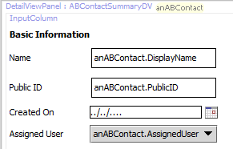
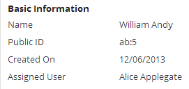
Each data widget is tied to one field (1)
ABContact
DisplayName
PublicID
CreateTime
AssignedUser
Each input and cell widget is bound to one field from the require variable object
Displays data for that object field or property
Notes:
<number>

Slide 8
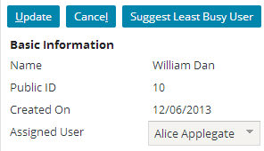
Each data widget is tied to one field (2)
ABContact
DisplayName
PublicID
CreateTime
AssignedUser
Editable fields with modified data committed to the database
DisplayName is a read-only property
PublicID and CreateTime are read-only system fields
AssignedUser is data backed
Notes:
If the root object field is editable and the widget is enabled to be editable, then changed data is committed to the database. In the slide example, only AssignedUser is an editable, data backed field for the anABContact required variable. DisplayName is an internal property for entity names. PublicID and CreateTime are read-only fields.
<number>

Slide 9
Atomic widget fundamentals
Creating atomic widgets
Binding widgets to the data model
Widget labels and display keys
Widget properties
Deploy the PCF and display keys
Notes:
<number>

Slide 10
Steps to create an atomic widget
Select the widget from the toolbox
Add the widget to the PCF
Specify the required properties
id property is unique name for widget
value property is for widget that display data
Specify a display key for the label property
Define additional properties specific to the widget type
Deploy the PCFs and display keys
Notes:
Guidewire recommends using "Ext" prefix for display keys. In a given widget property, specify the display key name. If necessary, localize display key values.
<number>

Slide 11
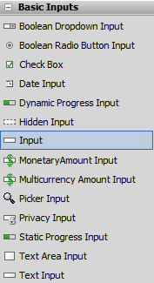
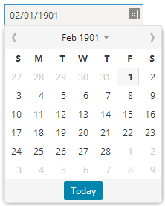
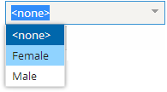
Generic input widget
Dynamically determines input type based on value data type
Boolean → Boolean Radio Input
Date → Date Input
TypeKey → TypeKey Input
Text → TextInput
Use has performance cost
Notes:
Input widget has only standard input properties and it renders various data types:
Text field when underlying field is numeric or varchar
Date formatted field when underlying field is datetime
Dropdown when underlying field is typekey
Yes and no radio buttons when underlying field is boolean
If no such mapping is found, the default is to use a TextInput.
It may seem negligible, but to resolve the underlying data type for the widget value takes extra application processing. In aggregate, widget resolution can be a performance issue. Wherever possible, use the input widget that best matches the needs of the user, widget special properties, and the underlying data type value.
Later, this lesson discusses how to choose the best input widget for the data value.
<number>

Slide 12

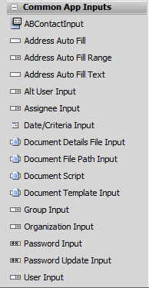


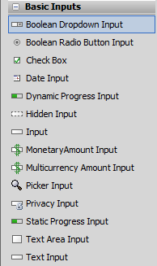
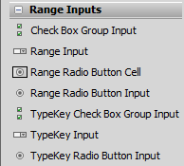
Step 1: Select the widget
Toolbox lists atomic widgets
Choose the best widget for the data value
Notes:
Atomic widgets are created by adding a widget into a container widget, such as a detail view panel, list view panel, or toolbar. Widgets are listed in the Toolbox tab, which appears on the right side of the PCF Editor. Initially, all widgets are listed. You can, however, enter a string into the filter field, which causes the Toolbox to list only widgets whose descriptions contain that string. To view a widget tool description, mouse over the name of the widget tool in the Toolbox. The description appears in a tooltip. Since PCF files are XML documents, each widget in the toolbox represents a specific XML element.
Later, this lesson discusses how to choose the best input widget for the data value.
<number>

Slide 13
Data values for input and cell widgets
Data | Input Widget | Cell Widget
varchar, integer, decimal | Text Input | Text Cell
varchar, shorttext, mediumtext, longtext, text | Text Area Input | Text Area Cell
date, datetime | Date Input | Date Cell
money | MonetaryAmount Input | MonetaryAmount Cell
bit | Boolean Dropdown Input Boolean Radio Button Input Check Box Input | Check Box Cell Radio Button Cell
array, foreignkey | Range Input Range Radio Button Input | Range Cell Range Radio Button Cell
typekey | TypeKey Input TypeKey Radio Button Input | Typekey Cell
Notes:
Later, this lesson discusses how to choose the best input widget for the data value.
<number>

Slide 14
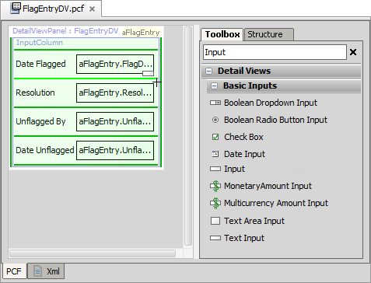
Step 2: Add the widget to the PCF
Light green line - current place where new widget will go
Dark green line - places where new widget can go
Notes:
To add a widget, click its name in the Toolbox and hold the mouse cursor down. As you begin to drag the widget, Studio changes the mouse cursor so that it includes the icon for that widget. Studio places a green line on the canvas at every location on the canvas that it is possible to place the widget. Studio highlights the green line that is nearest on the canvas to the cursor. Studio also overlays in green the element containing the highlighted green line.
In the slide example, the screenshot shows the use of the generic input widget. Later, this lesson discusses how to choose the best input widget for the data value.
<number>

Slide 15
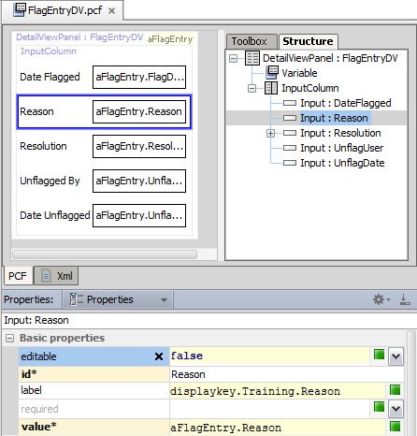
Step 3: Specify the required properties
Select element in
Structure tab
Editor canvas
View and/or edit element properties in Properties Window
Required properties indicated with asterisk ( )
id*
value*
*
Notes:
All PCF elements have definable properties in the Properties window. To view properties of a PCF file, click its title link in the upper-left corner. To view properties of any element, click that element.
The Properties window contains multiple property tabs. Click a tab to edit the associated properties. Some properties are not editable. Other properties are required. Required properties have an asterisk and the property name appears against a yellow background.
If you select a property, variable, or entry point, an "X" icon appears on the right-hand side of the cell for that property, variable, or entry point. You can click the "X" to restore the selected property, variable, or entry point to its default value.
The Properties window validates each property expression and/or value.
In the slide example, the screenshot shows the use of the generic input widget. Later, this lesson discusses how to choose the best input widget for the data value.
<number>

Slide 16
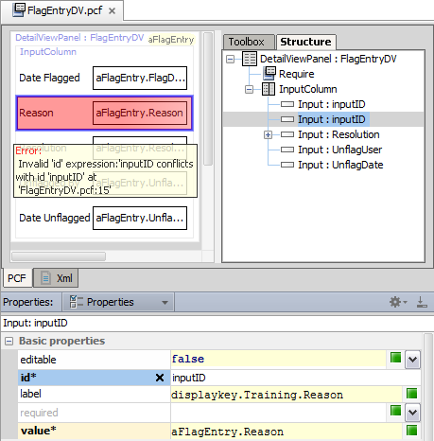
Step 3a: Specify the ID property
PCF validation will display error in canvas when two widgets have the same value for an id property
id* property must be unique within a given PCF
id property not required for all types of widgets
Notes:
Most atomic widgets require IDs. However, some widgets, such as labels and dividers, do not require IDs.
In the slide example, the screenshot show the use of the generic input widget. Later, this lesson discusses how to choose the best input widget for the data value.
<number>

Slide 17
Atomic widget fundamentals
Creating atomic widgets
Binding widgets to the data model
Widget labels and display keys
Widget properties
Deploy the PCF and display keys
Notes:
<number>

Slide 18
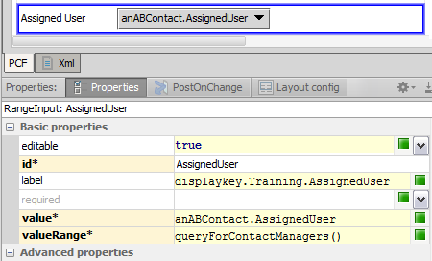
Step 3b: Specify the value property
Value property defines the data field
If a data field, can set the editable property of the widget to true
Specify field using dot notation
Reference direct object field or related object field
Only data fields are editable
Notes:
The value property is a dynamic property. The value property evaluates an object expression that binds the object property to it. For a given widget, the value property identifies the data field.
<number>

Slide 19
Dot notation and subtype casting
PCF specifies object variable datatype
Cast subtype reference
Run-time memory
Entity subtypes
var anABContact : ABContact
anABContact.EmailAddress
(anABContact as ABPerson) .Gender
(anABContact as ABPersonVendor) .SelfEmployed_Ext
(anABContact as ABDoctor)
.MedicalLicense
Notes:
When a Guidewire application retrieves data from the database, it stores that data as an object in runtime memory. It works with the in-memory information until the data needs to be committed or re-retrieved from the database.
When an object is created, all of the information about the object is copied into memory. If the object is subtyped, then data for all the fields at every relevant subtype level is retrieved. For example, if an object is an ABDoctor, then information is copied over for fields at the ABContact, ABPerson, ABPersonVendor, and ABDoctor levels. Fields associated with ABPlace, ABCompany, or ABAttorney are irrelevant and ignored.
When an object is referenced, the server uses the datatype of the reference to understand the structure of the information in memory. For example, assume that there is an object named "anABContact" that stores information about an ABDoctor. If there is a reference to this object with a datatype of "ABDoctor", then the server knows that the object will have ABContact fields, ABPerson fields, ABPersonVendor fields, and ABDoctor fields. If there is a reference to this object with a datatype of "ABPerson", then the server knows that the object will have ABContact fields and ABPerson fields, but it will assume that the object has no fields beyond the ABPerson fields. There may be additional fields with information at the ABPersonVendor and ABDoctor levels, but the server will be unaware of them.
In some cases, a method or user interface container receives a reference to an object, and the reference uses a "high-level" datatype (such as ABContact). This reference cannot be used as-is to access fields below the specified level because the server assumes those fields don't exist. There is a programming technique known as casting in which you explicitly state the datatype for a subtyped object. This is done using the syntax "as <datatype>", where <datatype> is the datatype that you want to explicitly identify. When you cast a reference, you are providing the server with more information about the structure of the object. A casted reference can access fields that an uncasted reference cannot.
<number>

Slide 20
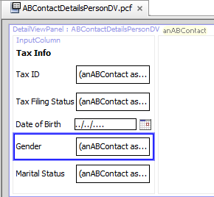
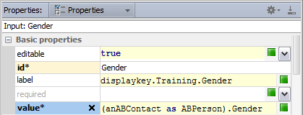
Pointing to fields at subtype level
Cast the object to subtype
root object has a supertype datatype and the desired field is at subtype level
Syntax
(object as Subtype).subtypeField
(anABContact as ABPerson).Gender
Notes:
<number>

Slide 21
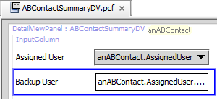
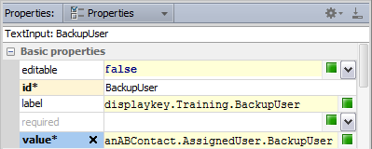
Pointing to fields on related objects
ABContact
User
User
William Andy
Alice Applegate
Edward Lee
AssignedUser
BackupUser
JobTitle
PublicID
CreateTime
BackupUser
Notes:
In some cases, the desired field is on a related object. The syntax to reference fields on related objects is: object.foreignKeyToRelatedObject.Field.
<number>

Slide 22
Atomic widget fundamentals
Creating atomic widgets
Binding widgets to the data model
Widget labels and display keys
Widget properties
Deploy the PCF and display keys
Notes:
<number>

Slide 23
Structure, function, and text
Use display keys for label values
Easily localize text and accommodate users from various locales
Allows for labels with dynamic content
Guidewire recommends PCF file should not contain "hard coded" display text such as label text
PCF file defines structure and function of containers
Label1
Label2
anABContact.DisplayName
Label3
anABContact.ID
Label4
anABContact.CreateTime
Label5
anABContact.AssignedUser
ABContactSummaryDV.pcf
Notes:
The label property evaluates a string expression. Display keys are a type of string expression in Guidewire applications for localizing text.
<number>

Slide 24
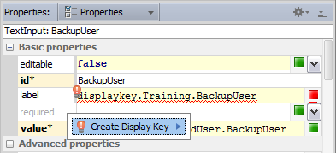
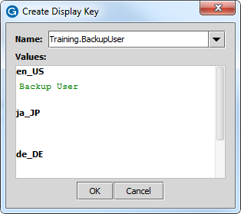


Step 4: Specify a display key for the label
1
2
3
Enter the displaykey name in the label property
Click Create Display Key
In the Create Display Key dialog, for the locale, enter the text value
Refresh the PCF
4
Notes:
When you defined a value for a label property, you have the option to create a new a display key for the value or specify an existing display key for the property value.
Enter a display key name in the label property. A display key name cannot have a space in it. After you enter a new display key name, you will be prompted to create a display key.
Next you should enter whatever you want to appear as the label for the new widget. You can enter in English, Japanese, German, and French.
Save the additions you made in the display key editor (you can verify that the new key is in the display.properties file in the Localizations).
To see the changes in Studio, go back to Studio and click on the Refresh PCF button.
The slide example shows a display key prefix named "Training". All TrainingApp display keys have the Training prefix. The recommended naming convention for customer display keys, however, is to a standard prefix such as "Ext". To reference a display key, always start with displaykey followed by a prefix and then the name of the display key.
<number>

Slide 25
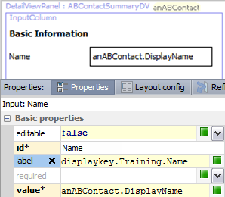


Display key example
displaykey.Training.Name Locale Value English Name
French Nom
Japanese 名前 Spanish Nombre
ABContactSummaryDV.pcf
User: John Miller Locale: English (United States)
User: Jean-Luc Monet
Locale: Français (France)
Notes:
A display key is a text string displayed on the user interface. Every display key has one or more localized values. When a PCF file references a display key, the application converts the display key to one of the localized values depending on the user's internationalization language settings. In the example above, the display key "Name" is converted to "Name" for users with their language set to English, "Nombre" for users with their language set to Spanish, and "Nom" for with their language set to French.
<number>

Slide 26
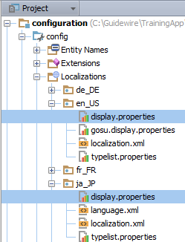


display.properties
display.properties files contains all display keys for a given localization folder
Open and edit file with the Display Key text editor
Notes:
Because the display.properties file is associated with a physical folder that reads "locale", there is often confusion between the difference between language and locale. Locale settings relate to national and cultural settings for how to display information such as numbers, currency, and dates. Language settings relate to the user selected language which localizes the application in that selected language.
Guidewire applications that are configured to support additional languages use the related display.properties file and its defined display key values. If no display key is defined for the selected language, the application uses the default language display.properties file. A setting in the config.xml file defines the default language for a Guidewire application.
<number>

Slide 27
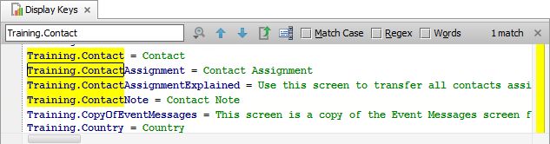

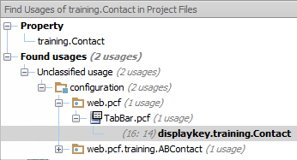
Display Keys text editor
Edit display keys for a given locale
display.properties file
Edit, and sort
ALT+ENTER
Find Usages
ALT+F7
Notes:
Often when working with PCF files and widget properties, you want to use a display key for a localized value as in the case of defining a value for widget's label property. You can create, edit, and remove display keys with the Display Keys text editor.
<number>

Slide 28
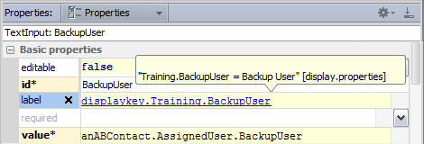

Edit a display key label value
CTRL+HOVER
Shows value of defined display key
CTRL+CLICK
Navigate to display.properties
Notes:
Both keystroke techniques work for a variety of items.
For example, a detail view panel can be embedded in a screen using a PanelRef widget. The PanelRef has a property that names which detail view panel to embed. From the PanelRef widget, you can CTRL+CLICK the name of the referenced detail view panel to open it in the PCF Editor.
<number>

Slide 29

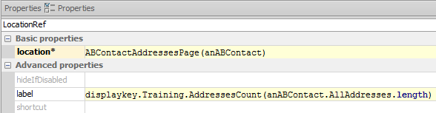
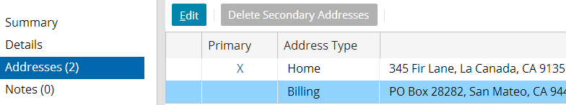
Display keys with dynamic content
{#} is a token for an input parameter data starting at a zero index
{0} is first parameter
Notes:
A display key can have one or more arguments. Each argument is noted by "{X}", where X is an integer. If there is only one argument, then the integer should be 0. If there are multiple arguments, then the arguments should be numbered starting with 0. When there are multiple arguments, the first argument listed in the label property is assigned to the {0} position, the second to the {1} position, and so on. In the slide example, the label property specifies a display key with an argument. It is also passed a value, specifically the length of the AllAddresses array. The label is rendered using the named display key with the argument is the designated location.
As an example of a display key with multiple arguments, consider a display key "Training.DataChanged", which has the value: 'The object you are trying to update was changed by {1} at {0}. Please cancel and retry your change.'. At runtime, the values "Jan 13, 2009 11:32 AM" and "Alice Applegate" are passed to the display key. The message displayed would be: "The object you are trying to update was changed by Alice Applegate at Jan 13, 2009 11:32 AM. Please cancel and retry your change."
It also possible for a display key to reference another display key. The syntax for this is: {displayKeyToEmbed }. An example is Web.Admin.NewReportGroup{Web.Admin.AddReportGroup}.
Embedding display keys can make UI changes both easier and more difficult. It can ease the process of changing a given term. For example, changing "POs" to "Purchase Orders" could be easier if the term exists in only one display key that is embedded in other display keys. It can complicate the translation process, however, if you want to implement a multi-lingual instance of the Guidewire application. Word order varies from language to language, and when you embed display keys in display keys, you start to "hard code" the word order. A given phrase may consist of contiguous words in one language but not in the other.
<number>

Slide 30
Atomic widget basics
Creating widgets
Binding widgets to the data model
Widget labels and display keys
Widget properties
Deploy PCFs and display keys
Notes:
<number>

Slide 31
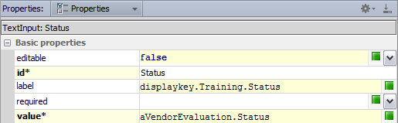
Two kinds of widget properties
Static Property
Evaluates a static value that is immutable, never changes
id requires a static value
Dynamic Property
After a user navigates to a page or clicks update, evaluates an expression and returns a value
editable requires boolean expression
label requires a string expression
value requires an object expression
Notes:
In the slide example, the id property of a widget is a static property. The widget always has the same ID, regardless of the state of the application or the values of any business data. The property does not evaluate an expression, just the value of a type, such as a String or Integer value.
The editable property evaluates a boolean expression and the expression can be a dynamic value, in this case, one that returns true or false. The label property evaluates a string expression. This lesson discusses display keys later on. Display keys are a type of string expression in Guidewire applications for localizing text. The value property is also a dynamic property. The value property evaluates an object expression that binds the object property to it.
Both static and dynamic widget properties can be required properties as indicated by an asterisk.
<number>

Slide 32
Common dynamic properties for widgets
Available
Boolean expression which, if false, grays out the widget and its children
Editable
Boolean expression which, if false, makes the widget and its children read-only
Required
Boolean expression which, if true, then a value must be filled out by the user
Visible
Boolean expression which, if false, completely hides the widget and its children
Notes:
Visible is typically not set to false. It is either set to true or it is set to an expression that renders the widget visible or not visible. The default value for the visible property is true.
<number>

Slide 33
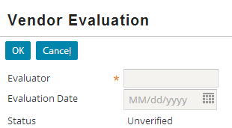
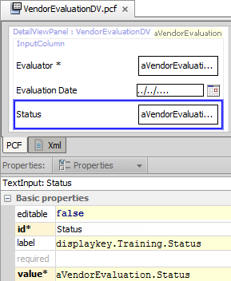
Step 5: Optional widget properties (1)
editable = false
Widget is read-only
Default is false
editable = true
If in edit mode, widget value can be edited
Notes:
The required variable for the VendorEvaluationDV.pcf file is aVendorEvaluation of the type VendorEvaluation. The VendorEvaluation entity describes the Status field. The Status field is a typekey defined by a value from the VendorEvaluationStatus typelist. For this entity typekey, the default value is unverified. The Status field can also contain a null value.
However, in the VendorEvaluationDV, the Status widget does not allow the Status property to be editable. This results in the value to always use the default value as described by the VendorEvaluation entity.
Later lessons discuss the difference between edit mode and read-only modes.
<number>

Slide 34
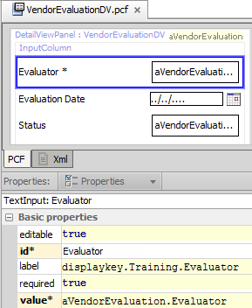
Step 5: Optional widget properties (2)
required = true
Value must be specified
Asterisk (*) denotes required field
Notes:
The required property is a dynamic widget property. When set to true, an asterisk appears in the user interface when the page is in edit mode. Edit mode is dicussed in later lessons. Often, when the required property expression evaluates to true, the editable property expression also evaluate to true.
The root object for the VendorEvaluationDV.pcf file is aVendorEvaluation of the type VendorEvaluation. The VendorEvaluation entity describes the Evaluator field. The Evaluator field is a varchar data field that can be null. No default value is defined for the field. However, in the VendorEvaluationDV, the Evaluator widget does not allow the Evaluator field to have a null value. The Evaluator widget defines properties for making the widget both editable and required.
If the VendorEvaluation entity defines the Evaluator field as non-null (null=false), then the Evaluator widget shows the field to be required in the case when the required property is undefined. If the required property is set to false, then the widget will override this behavior. The result could be a DBNullConstraintException when a user attempts to commit the data.
<number>

Slide 35

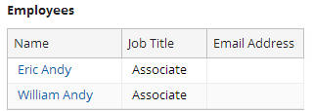
Examples of other optional properties
inputConversion
align
outputConversion
labelAbove
5400-3256-2211-5423
ACME
Notes:
outputConversion is a Gosu expression property that modifies the value stored in the database before it is displayed in the user interface. For example, it can be used to mask all but the last 4 digits of a credit card number.
inputConversion is a Gosu expression property that modifies the value displayed in the user interface before it is stored in the database. For example, it can be used to convert any entered stock symbol into all upper-case characters.
align is a property that can be set to either "left", "center", or "right". It impacts the alignment of data in the corresponding widget.
labelAbove is a boolean property for widgets with labels and fields. When set to true, the widget's label is displayed above the field, rather than to the left of the field. In the slide example, the Employer widget has the labelAbove set to true.
<number>

Slide 36
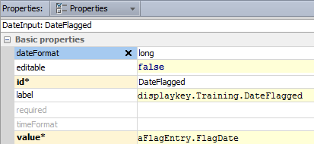


Specialized widgets have extra properties
Specialized widgets include additional properties for finer level of control
Notes:
<number>

Slide 37
Specialzied atomic input widgets
Basic
Boolean Dropdown Input
Boolean Radio Button Input
Check Box Input
Date Input
Monetary Amount Input
Multicurrency Amount Input
Text Area Input
Text Input
Range
Range Input
Range Radio Button Input
TypeKey Input
TypeKey Radio Button Input
Notes:
<number>

Slide 38
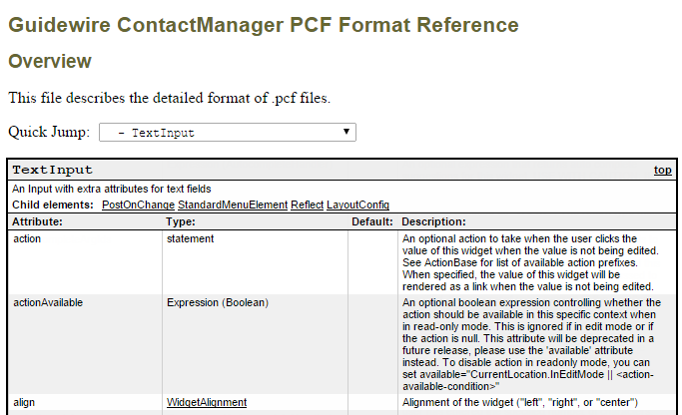
Documentation for all widget properties
This file is in: <Application>\modules\pcf.html
Notes:
The PCF Format Reference defines the properties for every widget, including the type of value the property takes and a description of the widget. Note that the PCF Format Reference refers to widget properties as "Attributes".
The PCF Format Reference is located in <ApplicationRootDirectory>\modules\pcf.html.
<number>

Slide 39
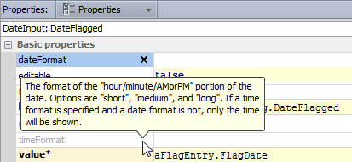
Property tooltips
Hover over a property name to view a tooltip
Display description of property from the PCF reference
Does not display property value type or defaults
Notes:
The PCF Re
<number>

Slide 40

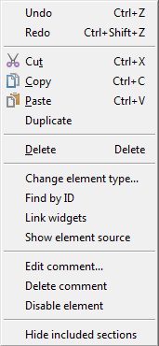
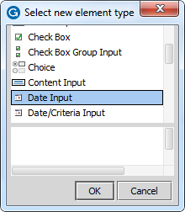
Change element type for atomic widgets
Select widget element in PCF Editor canvas
Right click to open context menu
Change element type…
Opens dialog of possible substitutes
Make change selection in dialog
Notes:
"Change element type…" context menu command substitutes a different element for the selected element. The dialog contains a list of element types that you can substitute for the selected element within the constraints of the PCF schema.
<number>

Slide 41
Atomic widget basics
Creating widgets
Binding widgets to the data model
Widget labels and display keys
Widget properties
Deploy PCFs and display keys
Notes:
<number>

Slide 42
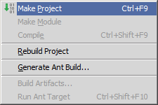
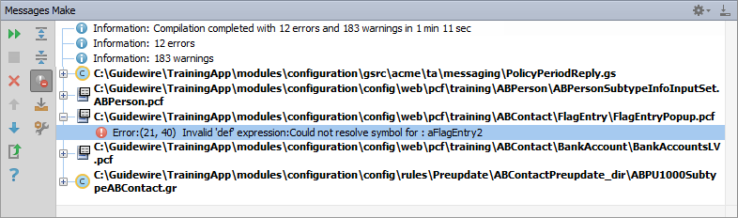
Make project to see all PCF errors
Build → Make Project
Compiles only modified files since the last compilation
Opens Messages (Make) window for build summary
Filter for errors
Great way to see all PCF errors
Notes:
Make Project: All the source files in the entire project that have been modified since the last compilation are compiled. Dependent source files, if appropriate, are also compiled. Additionally, the tasks tied to the compilation or make process on modified sources are performed.
<number>

Slide 43
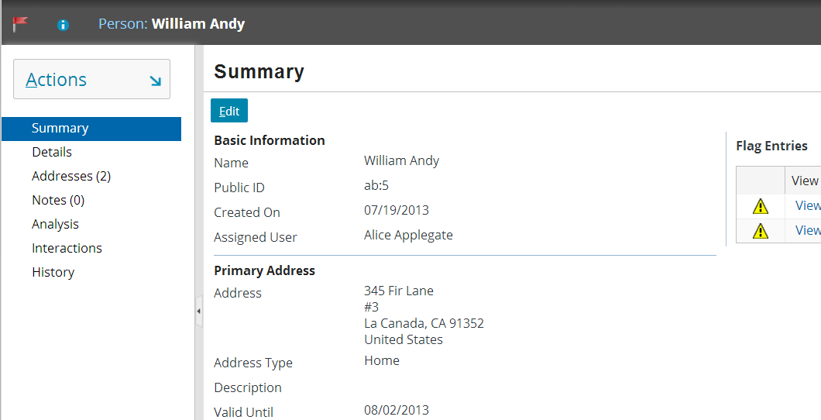
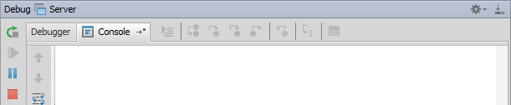
Internal debug tools: Reload PCFs ALT+SHIFT+L
ALT+SHIFT+L
2014-01-13 15:16:06,573 INFO PCFs reloaded.
Reloads all Page Configuration Files
Command window or Guidewire Studio Console window (Debug / Run) details output
Notes:
If you are running an open application project in Guidewire Studio and if internal tools are enabled, you can reload all the page configuration files and displaykeys for the server.
If you reload PCF files while in edit mode, you may experience unpredictable results. For the current location, where there is a data modification in progress, the new PCFs may not be reloaded. Therefore, Guidewire recommends reloading PCF files while in read-only mode as it provides for more predictable results.
<number>

Slide 44
Step 6: Deploy PCF files and display keys
Restart Server
Reload PCFs
PCFs read at server startup
ALT+SHIFT+L
Internal debug tools enabled
Internal Tools
Reload → Reload PCF Files
Page Configuration File
Display Properties
Page Configuration File
Display Properties
Notes:
It is also possible to reload PCF files using the Guidewire API and/or internal server tools. The Reload PCF command can be found on the Reload page in Internal Tools. To access Internal Tools, the EnableInternalDebugTools setting in the config.xml file must be set to true. The keystroke to open the Internal Tools page is ALT+SHIFT+T. In the tab bar, select Internal Tools --> Reload. On the Reload page, click the Reload PCF Files button. Both the keystroke ALT+SHIFT+L and the Reload PCF Files button call the same static method: gw.api.tools.InternalToolsUtil.reloadPCFs().
<number>

Slide 45
Create atomic widgets
Bind an atomic widget to the data model
Create and modify widget labels
Differentiate between static and dynamic widget properties
Notes:
<number>

Slide 46

What must you specify in a widget's "value" property?
When would you see the keyword "as" in the value property?
What is a display key?
If you create a widget and specify only the ID, name, and label, is the widget visible? Editable? Required?
The screenshot shows a standard input widget. The customer requires a "long" date format. How could you implement this requirement?
Notes:
Answers
1) You must specify the field in the data model that the widget is bound to.
2) You would see the "as" when the container's base object is subtyped, and the field to which the widget must be bound is at one of the subtype levels.
3) A display key is an abstract display value referenced by a widget's label property. It can have one or more locale-specific values, and when the UI is rendered, the value matching the user's locale is used.
4)The widget will be visible, not editable, and not required.
5) You would need to recreate the widget using a date input. The date input widget contains properties to more finely control the widget behavior, such as the date format.
<number>

Slide 47
Notes:
<number>

